Slide 1

Agentic AI
27/April/2026
Presented by Malik Qadeer

Slide 2

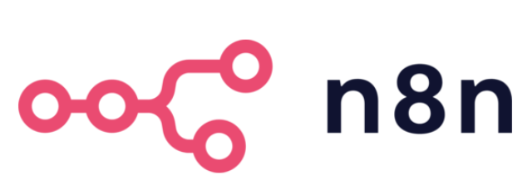


Available Platforms
n8n
make.com
There are many other platforms, but we are going to use n8n in this.
The purpose of using n8n is that it is more flexible and allows us to build detailed frameworks.
Presented by Malik Qadeer

Slide 3
n8n ?
n8n is an workflow automation tool.
More powerful and more customizable.
AI agents can multiply your productivity.
People are making $5k – 15k by selling it.
You need very basic knowledge of logic building No Need to be expert programmer.
Presented by Malik Qadeer

Slide 4

Automation vs AI Agent
Automation = Fixed logic
Trigger → Action → Output
Automation Concept
Trigger
Action
Output
Presented by Malik Qadeer

Slide 5
Automation
Presented by Malik Qadeer

Slide 6

Automation vs AI Agent
AI Agent = Adaptable to unique situation
Trigger → AI Action → Dynamic Output
AI Agent Concept
Trigger
AI Action
Results
Presented by Malik Qadeer

Slide 7
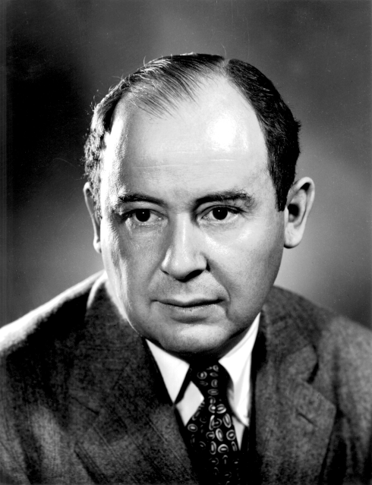
"Computers are like humans - they do everything except think"
John von Neumann
(1903 - 1957)
Presented by Malik Qadeer
Notes:
Computers are deterministic machines; they execute instructions based on electrical signals and logic gates. While modern AI can simulate reasoning and adapt to dynamic data, it lacks consciousness, intent, and subjective experience.

Slide 8
SUPER IMP SKILL
Inside the n8n Interface
Nodes: Trigger, Action, Utility, Code, Agent
Presented by Malik Qadeer

Slide 9
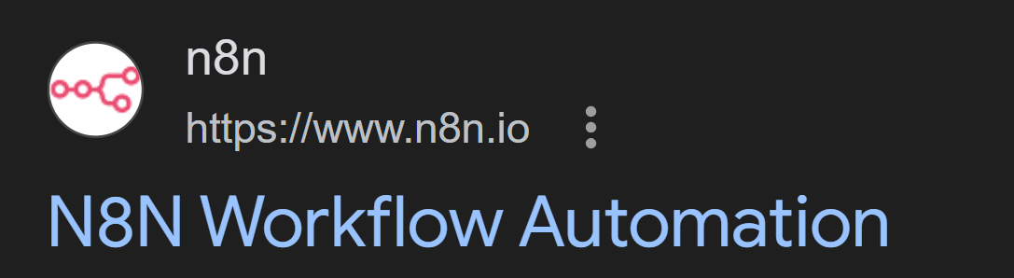
Search on google just “n8n”
Presented by Malik Qadeer

Slide 10
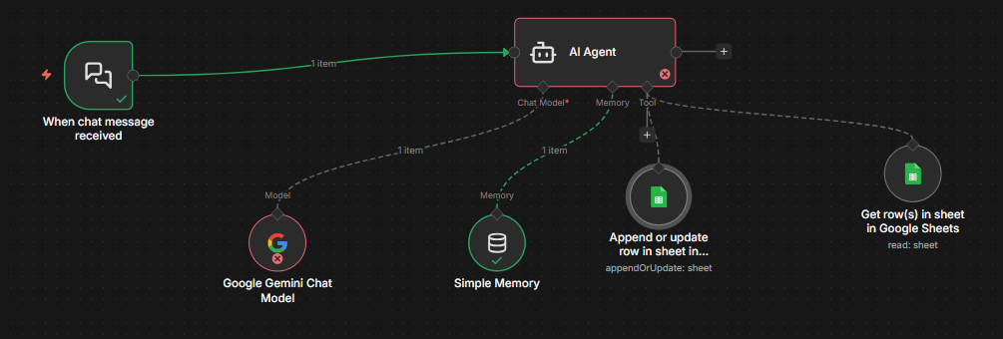
LIVE DEMO - Lets move to n8n
Presented by Malik Qadeer
Presented by Malik Qadeer

Slide 11
Q & A Session
Presented by Malik Qadeer
Notes:
1. AI Logic & Decision Making
"Why use an AI Agent instead of a simple form or a standard Google Sheets API?"
Strategic Answer: Conventional forms require strict inputs. An AI Agent allows for Natural Language Processing (NLP). A user can say, "Hey, we just received a box of 10 'Atomic Habits' books," and the agent intelligently identifies the book title, the action (increment), and the quantity without the user needing to navigate a complex UI.
"How does the Agent handle 'Hallucinations' or incorrect book updates?"
Strategic Answer: I implemented Guardrails. The agent doesn't just write to the sheet; it first retrieves the current inventory to verify if the book exists. I also use a "System Prompt" that forces the agent to return data in a specific JSON format, which is then validated by an IF Node before the sheet is updated.
2. Technical Architecture & Efficiency
"Google Sheets is not a real database. How will this scale if you have 10,000 books?"
Strategic Answer: For a MVP (Minimum Viable Product), Google Sheets is excellent for rapid deployment and visibility. However, n8n is database-agnostic. If the data grows, I can simply swap the Google Sheets node for a PostgreSQL or Supabase node without changing the AI logic.
"You encountered 'Rate Limit' errors earlier. How did you solve them for a 'Live' environment?"
Strategic Answer: I used Traffic Management techniques. I added a Wait Node to stagger requests and utilized Split in Batches to ensure the AI isn't overwhelmed. In a production environment, I would also implement a Redis queue to handle high-concurrency requests.
3. Integration & User Experience
"How do you ensure the website shows 'Real-Time' data if n8n is running in the background?"
Strategic Answer: I use a Webhook Response node. When the website sends a request, the n8n workflow doesn't just finish; it sends back the updated row data as a JSON object. The website’s frontend (JavaScript) then immediately updates the table without a page refresh.
"Can this system be integrated with other platforms like WhatsApp or Slack?"
Strategic Answer: Yes, that is the beauty of n8n. I can add a WhatsApp Business or Telegram trigger node to the same workflow. The same AI Agent logic would then process messages from those apps and update the same Google Sheet.
4. Security & Edge Cases
"What happens if two people update the same book at the exact same time?"
Strategic Answer: This is a Concurrency issue. To handle this, I can set the n8n workflow to "Execute Serially" (one after another) rather than in parallel, ensuring that each "Read-Modify-Write" cycle is completed before the next one starts.
"Is the data secure? How do you prevent unauthorized users from deleting your inventory?"
Strategic Answer: I use Webhook Authentication. The website sends a secret 'Header' or 'API Key' with every request. If the n8n Header check fails, the workflow terminates immediately before touching the Google Sheet.

Slide 12
Thank You!
Presented by Malik Qadeer

Slide 13
Steps to Turn an n8n Workflow Into a Web
Webhook Node: Use this as your workflow’s starting point to receive data from your website.
Respond to Webhook Node: Place this at the end to send data (like success messages or book lists) back to the user.
Frontend Interface: Build a simple HTML/JS page or a Flutter Web app to serve as the user dashboard.
Fetch API: Write JavaScript code on your website to send and receive data from the n8n Webhook URL.
Hosting: Deploy your frontend code on a platform like GitHub Pages, Vercel, or Netlify.
CORS Configuration: Update n8n settings to allow your website domain to communicate with the n8n server.
Presented by Malik Qadeer

